Slide 1
Efficient KNN Join Algorithm for spark
Presented by: Ramanathan Sivagurunathan
Professor Dr. Ying Zhou
School of Information Technologies

Slide 2
Background and Literature Review
Contribution and Algorithm Design
Experiments and Results
Conclusion and Future work
References

Slide 3
KNN Join
KNN Stands for K Nearest Neighbour
In KNN Join, for every vector in test vectors [V_{t1}, V_{t2} … V_{tn}], we find K nearest vectors in Training data [v₁, v₂ … v_{k}] and classify V_{tx} based on neighbour vectors’ class.
Applications:
Classifying Patient Symptoms with other previously treated patients for diagnosing rare diseases
Dating Profile matching
Drawback
High Computational Complexity => Not usable for big datasets
Notes:
No need for any preprocessing
Benchmarking other classifications
1M x 1M => 10¹² computation

Slide 4
Solution for Large datasets
Better Algorithm with lower computational complexity
Design a distributed algorithm for leveraging Distributed frameworks
Notes:
Does not reduce computational complexity but we leverage the warehouse scale machine availability , use them for parallel computation

Slide 5
Distributed Frameworks
There are two widely adopted Distributed Frameworks
Hadoop MapReduce
Designed for scalability not for performance
All intermediate results of tasks are stored in disks, resulting in high disk usage and lower performance
Spark
In Memory Data Processing Primitives giving high performance
Up to 100x faster than mapreduce when data fits in memory and 10x if it spills over disk
Considered as a replacement for Hadoop mapreduce
Due to these performance reasons we are designing our algorithm for spark, as it is the future

Slide 6
Previous Research Works
The Primary focus: To reduce the number of distance computation.
We can group all the algorithm into two groups
Accurate KNN
Approximate KNN
Most algorithms are focused on creating a spatial indexes
Mostly Focused on Centralized Algorithm
So far one research for Distributed Algorithm (for Hadoop Mapreduce)

Slide 7
Contribution and Algorithm Design
Experiments and Results
Conclusion and Future work
References

Slide 8
Contribution
We have taken some of the concepts like
Voronoi Partitioning ¹
Triangle Inequality for multidimensional points ²
Using them we have Designed an algorithm which is
Distributed
optimized for spark Framework
Iterative and incremental algorithm
Minimalistic in data replication which in turn reduces disk and memory usage
Effective and scalable for large and multidimensional dataset
Studied the effects of various parameters on running time, Memory, Disk Usage

Slide 9
Assumptions and Solution
Assumptions:
S dataset (Training Dataset) is very large
R dataset (Test dataset) is huge but smaller than S
R dataset changes but S dataset remains fixed
Solution:
Voronoi Partition Based iterative algorithm designed for Spark Framework
We look for neighbors of a test vector only from a limited subset of partitions

Slide 10
Solution Overview
Partition both R (test) and S (training)dataset using common pivots from S dataset
Except for point near the edge of the partition, most data should be able to find its neighbor within a single partition.
For every partition in R we find nearest neighbor within same partition in S. If the point in R is at the center of the partition then for all such points KNN computation is complete.
For all data points on the edge, we check all the nearby partitions and find nearest neighbors if present in it.

Slide 11
Voronoi Partition

Slide 12
Detailed Algorithm
Select Random Pivots
Assign vectors in both Training and Test Dataset to closest pivots. All vectors belonging to a pivot form a partition.
The partition data is stored in spark as a tuple of the form (partition_id, List(vectors))
Self Join: For any partition in Test Dataset, find k nearest neighbors in Training Dataset in the same partition.
Notes:
We have partition so that we can run operations like “map” in parallel
Partition id x in R and S dataset will be colocated. This avoids lots of shuffle

Slide 13
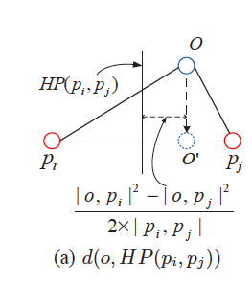
Detailed Algorithm …
If distance of nearest neighbor is less than distance to border then KNN Found for the vector
Else Move vector to another closest partition and find and update neighbors
Repeat until we find KNN for all the test vectors
Additional Optimization
Instead of moving to one partition we can replicate to “x” partition, and combine the results afterwards.
Distance to border
Notes:
Else Move the vector to another closest partition and find nearest neighbor in that partition nearer than previously found. In spark we achieve by repartitioning using “partitionBy”. Any vector which needs to be moved automatically gets moved to right partition.

Slide 14
Experiments and Results
Conclusion and Future work
References

Slide 15
Test Environment
Used Mesos for resource Management for Spark Tasks
Cluster contains
1 Master Node (8 vCPU with 16 GB RAM and 80 GB HDD)
10 Slave Nodes (8 vCPU with 16 GB RAM and 80 GB HDD)
Datasets
HIGGS Dataset with 11 Million Vectors. Each with 28 dimensions
Forest Dataset with 500K Vectors. Each with 10 dimensions

Slide 16
Test Environment …
Algorithms
Brute force algorithm
We have written a brute force algorithm which can leverage spark’s parallel in memory computation. This algorithm is also called as Block Nested Loop Join
We partitioning the data into smaller subsets in both R and S. This is to run the algorithm in parallel in all the nodes. Every subset in R will be searched with every subset in S.
R and S Dataset
We have kept both to be same so that we can calculate the worst case. Practically R dataset will be much smaller than S dataset

Slide 17
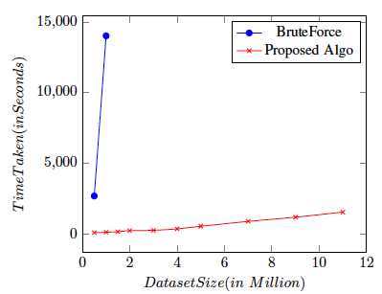
Result – Effect of size of dataset
Our proposed algorithm is approximately 100 times better performance than brute force algorithm in 1M x 1M join with 6 dimensions
The performance boost is mainly due to reduction in number of computation per vector in R dataset and Less data shuffles needed
The average computation per vector in our proposed algorithm is 10,000 where as in brute force it is 1000,000 for 1Mx1M join
Possibly about 800 - 1000 times better performance in 11M x 11M Join
Brute force has quadratic increase in time while our algorithm is near linear
This has zero disk usage and better network usage
k

Slide 18
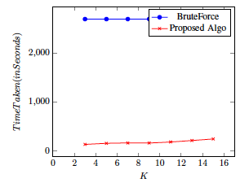
Result – Effect of Number of Neighbours
When K is increased the time taken slightly increases.
This is because a K is increased the distance between a point to its Kth neighbor increases and causing more points to be on the edge of the partition
If the number of created partitions is less then more comparison per partition and it can result in longer time
If the number of partition is also too small can result in more points on edge and causing lots of shuffle

Slide 19
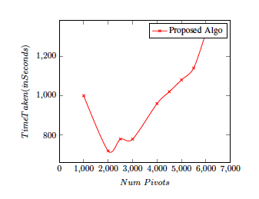
Result – Effect of Number of Pivots
The graph shows the effect of number of partitions on the performance
If the number of partitions is less then more comparison per vector is needed and it can result in longer time
If the number of partition is high then size of the partition becomes smaller, it can result in more points on edge and causing lots of shuffle

Slide 20
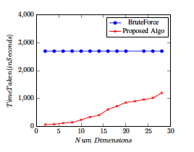
Result – Effect of Number of dimensions
The graph shows the effect of dimensions on run time.
With increasing dimensions, the performance drops a lot. As dimension grows beyond 12, the performance drops significantly as more and more points lie on the edge. But still the performance of our algorithm is better than brute force but not very highly though.

Slide 21
Conclusion and Future Work
References

Slide 22
Conclusion & Future Work
From the results our algorithm has
Faster Running time
Handle Large Datasets
Horizontally Scalable
Since the performance drops a lot for very high dimensional datasets, we need to work on Improving performance of the algorithm

Slide 23
References
Efficient parallel kNN joins for large data in MapReduce http://dl.acm.org/citation.cfm?id=2247602
Index-driven similarity search in metric spaces http://dl.acm.org/citation.cfm?id=958948
When is “nearest neighbor” meaningful? http://link.springer.com/chapter/10.1007/3-540-49257-7_15
http://hadoop.apache.org/
http://spark.apache.org/

Slide 24
Thank you

